Slide 1
Bi-model face recognition framework
[For expression invariant face recognition]

Slide 2

Expressions: Two perspectives.
1) Noise?

Slide 3

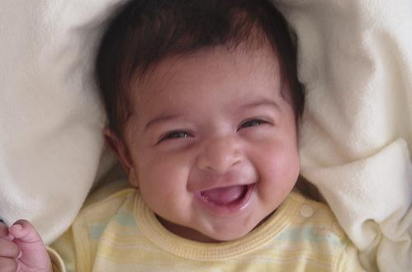
Expressions
11) Extra features ?
Essentially everyone has got a different smile here.

Slide 4
Outline
Principal Component Analysis
Reduce dimensionality.
Extract low dimensional features from original facial appearance.
Fisher Linear Discriminant Analysis
To maximize the discrimination between different classes.
Fusion of Modalities.
Well we have not done much of work on this front yet.

Slide 5
Principal Component Analysis [PCA]
What is it?
A way to identify patterns in the data.
Reduce or compress the data without loss of much information.
In our case: introduce generalization. What happens when we increase number of neurons?

Slide 6
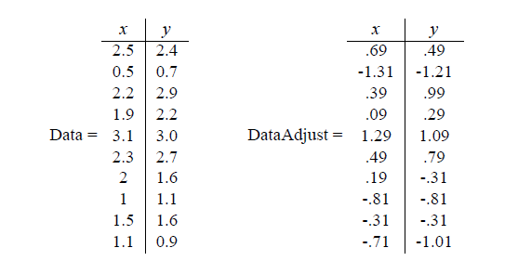
PCA : Walkthrough - 1
Get some data
Subtract the mean [Data Adjust].

Slide 7
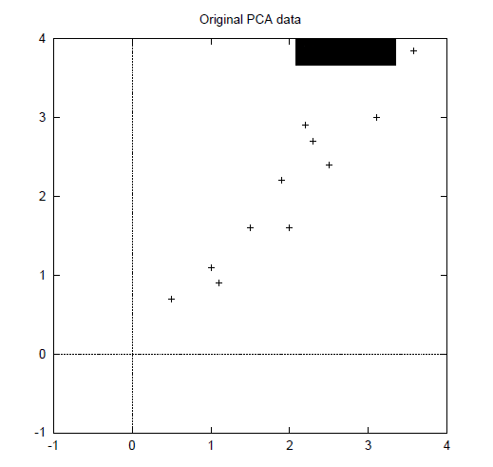
PCA : Walkthrough - 2
Data plotted on x-y

Slide 8

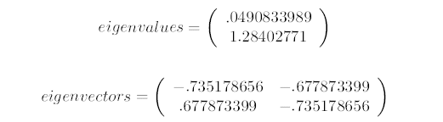
PCA : Walkthrough - 3
Calculate the covariance matrix
Calculate the eigenvalues and eigenvectors
The eigenvector with highest eigenvalue is Principal Component.

Slide 9
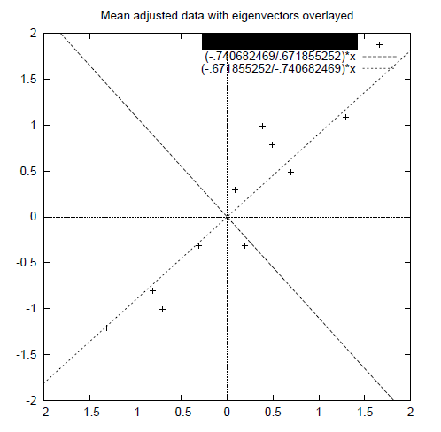
PCA : Walkthrough - 4

Slide 10
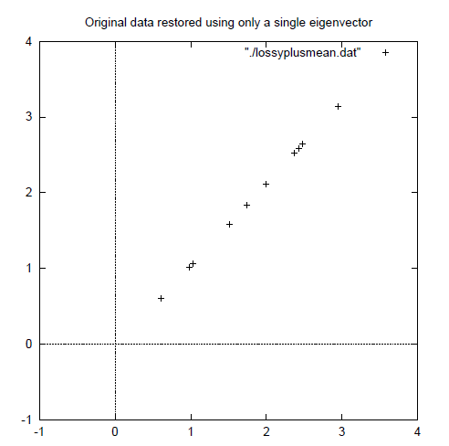
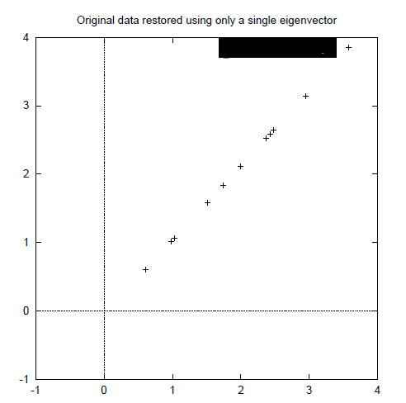
PCA : Walkthrough - 5

Slide 11
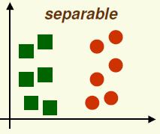

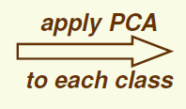
Fisher Linear Discriminant Analysis
PCA finds the most accurate data representation for lower dimensional space.
But directions of maximum variance may be useless for classification.
#Fail

Slide 12
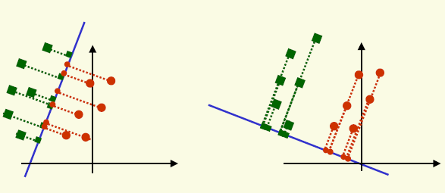
FLDA – Main idea
Find projection to a line, or plane in case of higher dimension such that different classes are well separated.

Slide 13
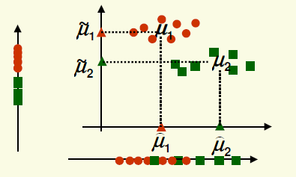

FLDA - 1
Find vector such that the distance between the projection of classes is maximum along that vector.
But how to define distance?
Good along vertical axis, not so good along horizontal axis
$$\left|μ1 − μ2\right|$$

Slide 14

FLDA - 2
The problem is that we did not consider *scatter* of the data.
Ok, wait!! What is scatter?
Scatter is variance multiplied by no. of elements.

Slide 15

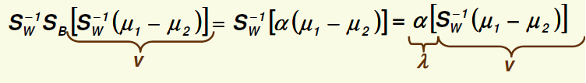

FLDA - 3
Fisher solution : Normalize by scatter.
Thus Fisher linear discriminant is to project on line in the direction of v which maximizes
J(v) is the distance between mean values of two classes which are normalized by scatter.
After performing few complicated looking simple vector algebraic steps we get
$$\left|μ1 − μ2\right|$$

Slide 16
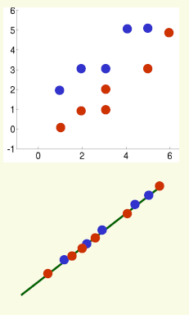
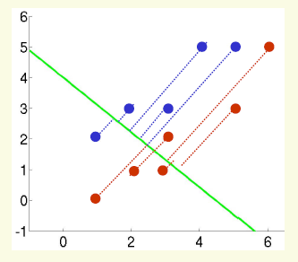
FLDA - Example
PCA FLDA

Slide 17
Multiple Modalities
Background
Rest of the story during final presentation and demo.

Slide 18
Questions?

Slide 19
Thank You

